Slide 1
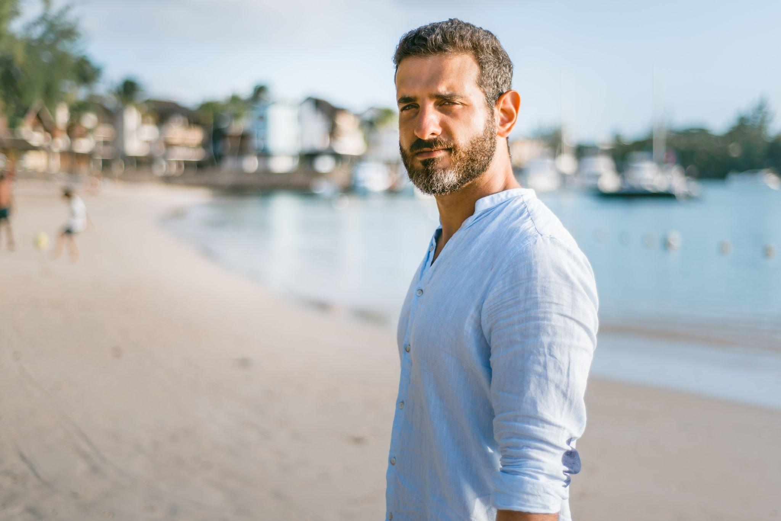
“If I don’t put effort in for my family, if some day I could not be of help, then I would regret it forever”
Add image that represents this persona
Goals
Wishes to be equipped with basic knowledge like CPR so that he can fulfil his duties
Wishes to advance in career
Frustrations
Hard to attend CPR training sessions because of his schedule
Wishes there was an app/ website online that would help him out
Rana Sawalha
Age:
Education:
Hometown:
Family:
Occupation:
52
MBA
Beaufort
Wife and 2 children
Marketing Manager
Rana Sawalha is a Marketing Manager at an MNC. He is a very busy individual who makes time for his family despite his tiring schedule. He wishes to be more responsible and prepared for any scenario and wants to be able to perform CPR in case something goes wrong. Since he won’t be able to take training personally, he wishes there was a guide website /app online that would help him learn how to give CPR.

Slide 2
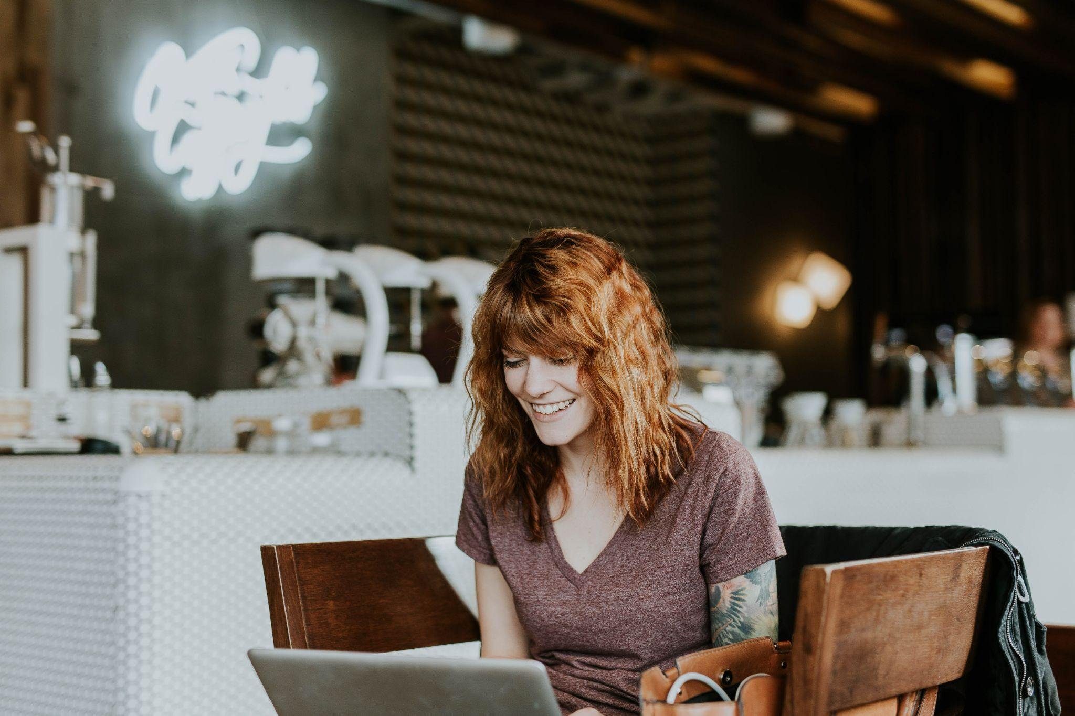
“We all have responsibility towards the world. All we need to do is take a small step. We could save a life!”
Add image that represents this persona
Goals
Help people
Take care of elderly parents
Get a PhD
Continue working for the needy
Frustrations
Basic first aid and CPR is not a part of education
Wishes that there were an easy way to learn all this so that people can be equipped beforehand
Ashley brooke
Age:
Education:
Hometown:
Family:
Occupation:
25 MSW
Los Angeles
Parents
Social Work
Ashley Brooke is an educated social worker. She is a responsible citizen and she wants to be equipped for any situation where people would need her help. She believes that basic first aid and CPR should be taught to all. She loves to volunteer and go hiking.

